Slide 1

InstaCart Data Warehouse
Sarthak Killedar
Rupali Shyam
Dilisha Naidu
Sayantani Bhattacharjee
Lakshmi Ravichandran
Sanzil Madye

Slide 2



We make use of the instaCart dataset to perform certain analysis on the data. This can help gain useful insight on the working and performance of a business.
As required by the project, the analysis is done using three different databases, relational DB, MongoDB and Neo4j.
Since the data is available in terms of tables/relations, the relational database would be an ideal choice.
We make use of 5 dimensional table such as Orders, Products, Aisle, Departments and Order Details to create the Fact Tables.

Slide 3
Product Fact Table
ProductID | Name | Department ID | Aisle ID
Aisle ID | Aisle
CREATE TABLE [dbo].[ProductStarFact](
[ProductId] [int] NOT NULL,
[DepartmentId] [int] NOT NULL,
[AisleId] [int] NOT NULL,
[Quantity] [int] NOT NULL,
CONSTRAINT [PK_ProductStarFact] PRIMARY KEY CLUSTERED ([ProductId] ASC)
Product ID | DepartmentID | AisleID | Quantity
Department ID | Department

Slide 4

MongoDb Structure
Product ID
DepartmentID
AisleID
Quantity
Products Collection
product_id | product_name | department [department_name] | aisle [aisle_name]
departments
aisles
Order-Product Collection
order_id | product_id | re-ordered | add_to_cart
Orders Collection
order_id | user_id | order_dow | order_hour_of_day

Slide 5

Neo4J (Graph Database)
For the right use case, relational databases are powerful tools. But today’s users are asking for more than an RDBMS can handle. More features, more data, more speed and – most importantly – more connections.
Property graph model and Cypher query language makes it easy to understand a database.
Neo4j delivers the lightning-fast read and write performance you need, while still protecting your data integrity. It is the only enterprise-strength graph database that combines native graph storage, scalable architecture optimized for speed, and ACID compliance to ensure predictability of relationship-based queries.
Competitive advantage in business using Neo4j like ebay’s competitive advantage in same-day delivery.g

Slide 6
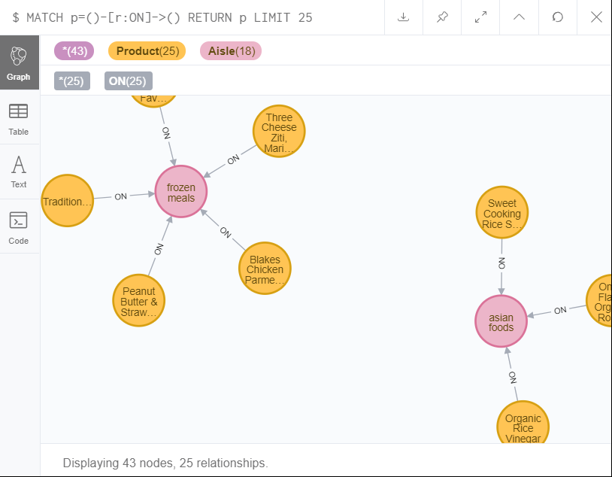
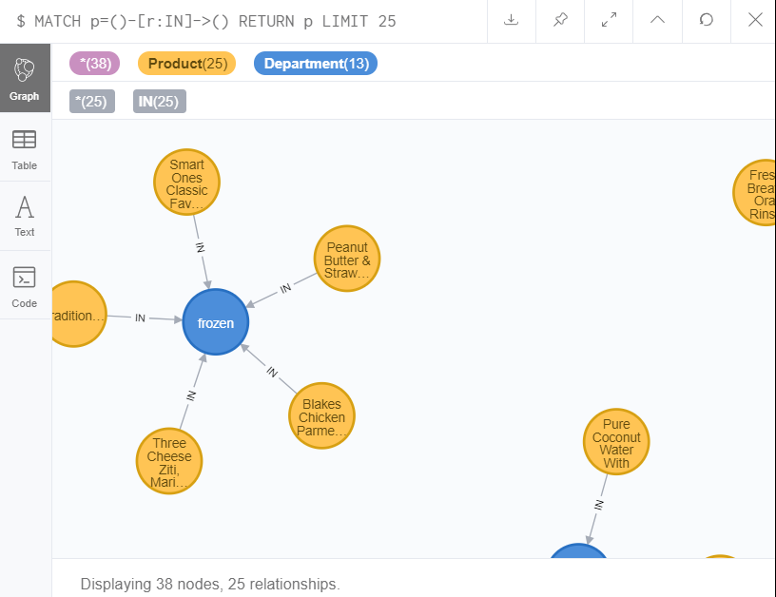
Relations
ON relation
IN relation

Slide 7
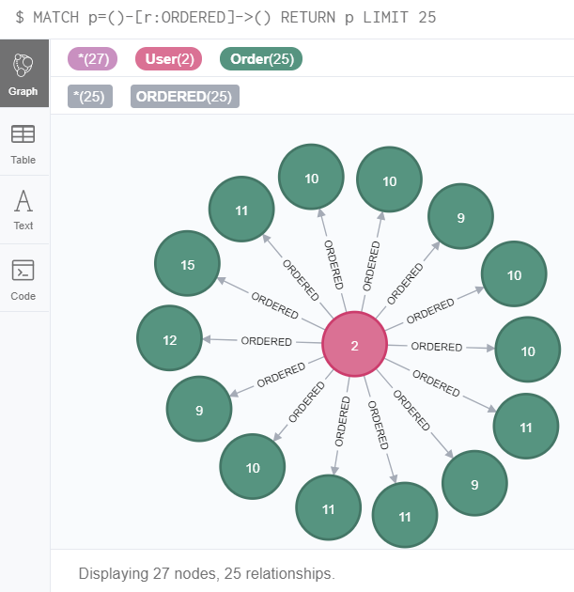
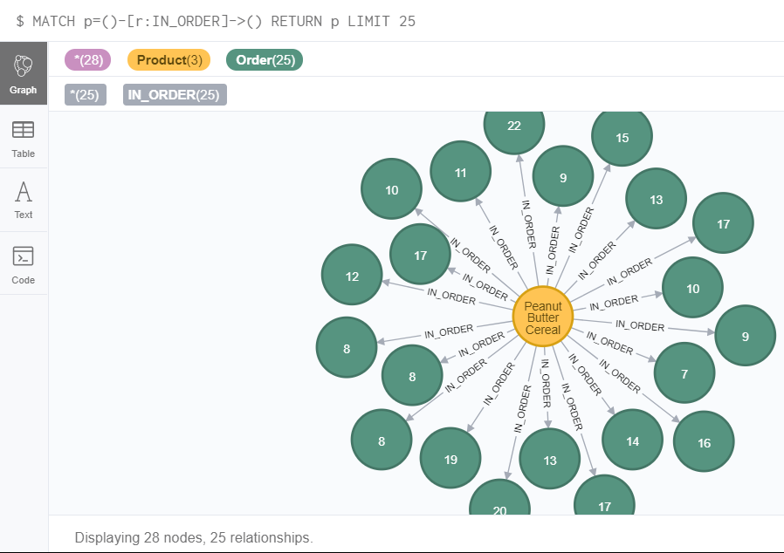
Relations -contd.
ORDERED
IN-ORDER

Slide 8
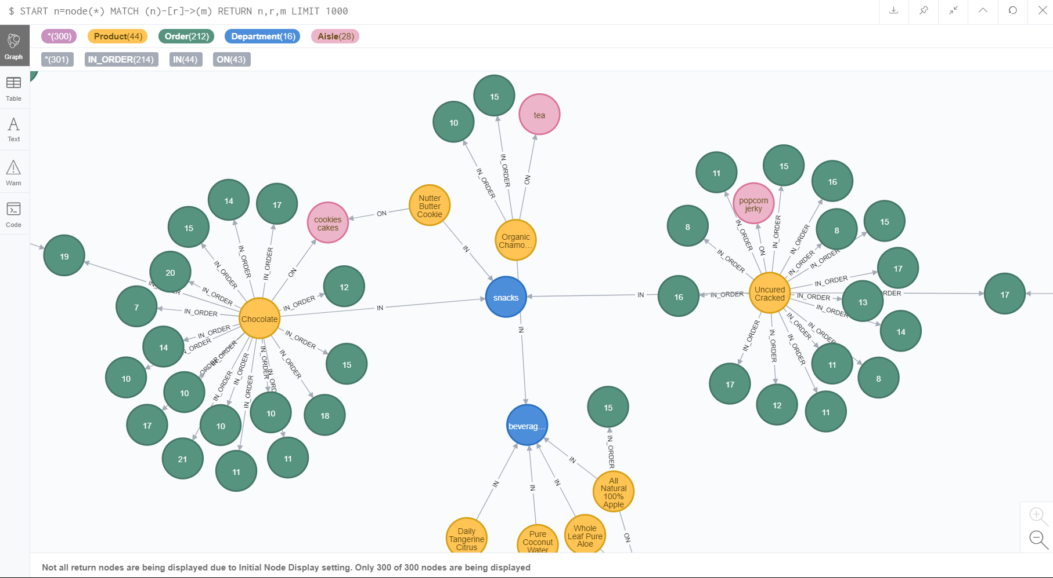
Graph Model

